Slide 1
Theme 9. Popular speech processing architectures

Slide 2
Google’s VoiceFilter (2019)
Separates the voice of a target speaker from multi-speaker signals, by making use of a reference signal from the target speaker.
Two separate neural networks:
A speaker recognition network that produces speaker-discriminative embeddings;
A spectrogram masking network that takes both noisy spectrogram and speaker embedding as input, and produces a mask.

Slide 3
Google’s VoiceFilter: encoder
The purpose of the speaker encoder is to produce a speaker embedding from an audio sample of the target speaker.
The speaker encoder is a 3-layer LSTM network trained with the generalized end-to-end loss. It takes as inputs log-mel filterbank energies extracted from windows of 1600 ms, and outputs speaker embeddings, called d-vectors, which have a fixed dimension of 256.
To compute a d-vector on one utterance, sliding windows with 50% overlap are extracted, and average the L2-normalized d-vectors obtained on each window

Slide 4
Google’s VoiceFilter: main part
The neural network takes two inputs: a d-vector of the target speaker, and a magnitude spectrogram computed from a noisy audio. The network predicts a soft mask, which is element-wise multiplied with the input (noisy) magnitude spectrogram to produce an enhanced magnitude spectrogram.
To obtain the enhanced waveform, the phase of the noisy audio is directly merged to the enhanced magnitude spectrogram, and an inverse STFT is applied on the result. The network is trained to minimize the difference between the masked magnitude spectrogram and the target magnitude spectrogram computed from the clean audio.

Slide 5
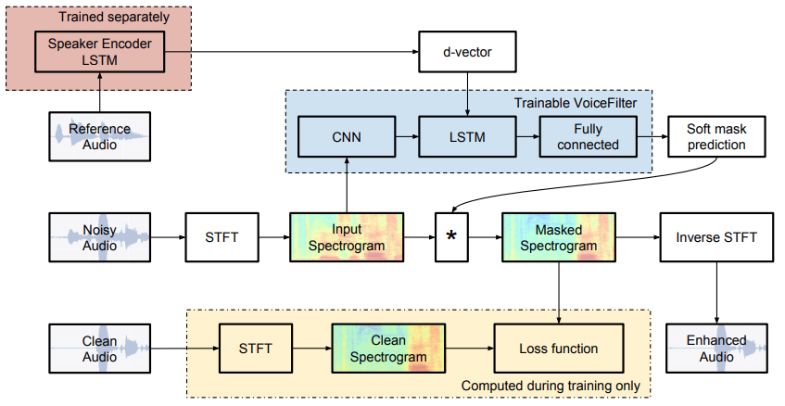
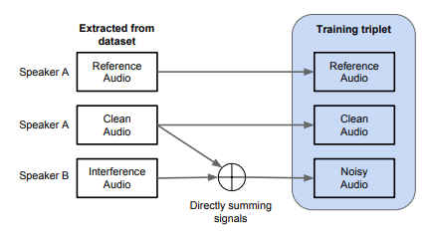
Google’s VoiceFilter: main part
The VoiceFilter network is composed of 8 convolutional layers, 1 LSTM layer, and 2 fully connected layers, each with ReLU activations except the last layer, which has a sigmoid activation.
The d-vector is repeatedly concatenated to the output of the last convolutional layer in every time frame. The resulting concatenated vector is then fed as the input to the following LSTM layers.
The d-vector is injected between the convolutional layers and the LSTM layer and not before the convolutional layers for two reasons. First, the d-vector is already a compact and robust representation of the target speaker, thus we do not need to modify it by applying convolutional layers on top of it. Secondly, convolutional layers assume time and frequency homogeneity, and thus cannot be applied on an input composed of two completely different signals: a magnitude spectrogram and a speaker embedding.
While training the VoiceFilter system, the input audios are divided into segments of 3 seconds each and are converted, if necessary, to single channel audios with a sampling rate of 16 kHz.

Slide 6
TasNet (2018)
Most methods (VF included) attempt to construct a mask for each source in time-frequency representation of the mixture signal which is not necessarily an optimal representation for speech separation.
Time-frequency decomposition results in inherent problems such as phase/magnitude decoupling and long time window which is required to achieve sufficient frequency resolution.
TasNet directly models the signal in the time-domain using an encoder-decoder framework and perform the source separation on nonnegative encoder outputs. This method removes the frequency decomposition step and reduces the separation problem to estimation of source masks on encoder outputs which is then synthesized by the decoder.

Slide 7
TasNet (2018)
The mixture waveform is represented by a nonnegative weighted sum of N basis signals, where the weights are the outputs of the encoder, and the basis signals are the filters of the decoder. The separation is done by estimating the weights that correspond to each source from the mixture weight.
Because the weights are nonnegative, the estimation of source weights can be formulated as finding the masks which indicate the contribution of each source to the mixture weight, similar to the T-F masks that are used in STFT systems. The source waveforms are then reconstructed using the learned decoder.
This signal factorization technique shares the motivation behind independent component analysis (ICA) with nonnegative mixing matrix and semi-nonnegative matrix factorization (semi-NMF). However unlike ICA or semi-NMF, the weights and the basis signals are learned in a nonnegative autoencoder framework, where the encoder is a 1-D convolutional layer and the decoder is a 1-D deconvolutional layer (also known as transposed convolutional). In this scenario, the mixture weights replace the commonly used STFT representations.
Since TasNet operates on waveform segments that can be as small as 5 ms, the system can be implemented in real-time with very low latency.

Slide 8
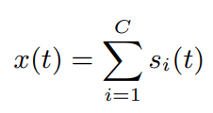
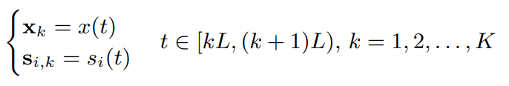
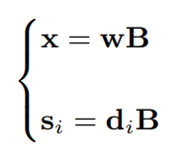
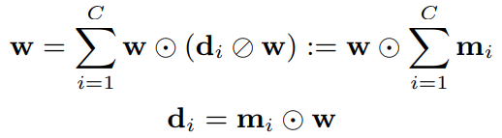
TasNet (2018)
The problem of single-channel speech separation is formulated as estimating C sources s₁(t), . . . , s_{c}(t), given the discrete waveform of the mixture x(t)
We first segment the mixture and clean sources into K nonoverlapping vectors of length L samples, x_{k} ∈ R^{1×L} (note that K varies from utterance to utterance)
Each segment of mixture and clean signals can be represented by a nonnegative weighted sum of N basis signals B = [b₁, b₂, . . . , b_{N} ] ∈ R^{N×L}
where w ∈ R ^{1×N} is the mixture weight vector, and d_{i} ∈ R^{1×N} is the weight vector for the source i. Separating the sources in this representation is then reformulated as estimating the weight matrix of each source d_{i} ∈ R^{1×N} given the mixture weight w
Because all weights (w, d_{i}) are nonnegative, estimating the weight of each source can be thought of as finding its corresponding mask-like vector, m_{i}, which is applied to the mixture weight, w, to recover D_{i}
where m_{i} ∈ R ^{1×N} represents the relative contribution source i to the mixture weight matrix, and ⊙ and ⊘ denotes element-wise multiplication and division

Slide 9
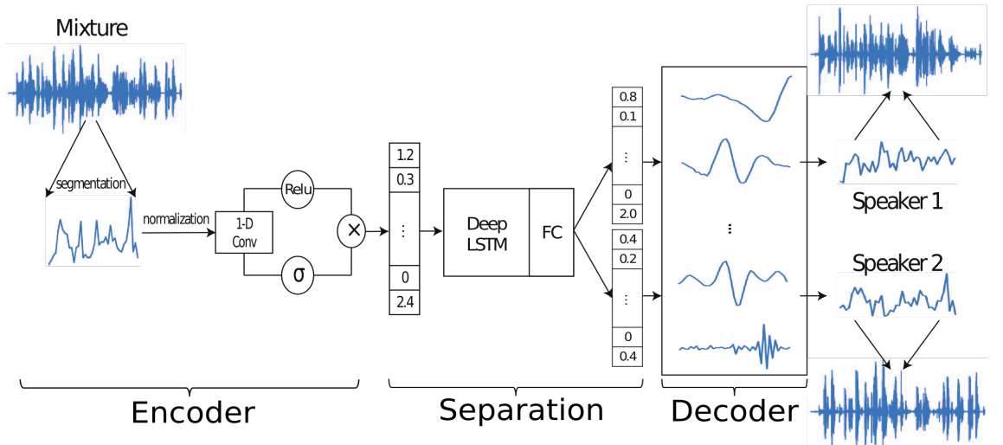
TasNet (2018)
Network design:
an encoder for estimating the mixture weight,
a separation module,
a decoder for source waveform reconstruction.
The combination of the encoder and the decoder modules construct a nonnegative autoencoder for the waveform of the mixture, where the nonnegative weights are calculated by the encoder and the basis signals are the 1-D filters in the decoder. The separation is performed on the mixture weight matrix using a subnetwork that estimates a mask for each source

Slide 10
TasNet (2018): network design
Encoder for mixture weight calculation
The estimation of the nonnegative mixture weight w_{k} for segment k is done by a 1-D gated convolutional layer
where U ∈ R ^{N×L} and V ∈ R ^{N×L} are N vectors with length L, and w_{k} ∈ R ^{1×N} is the mixture weight vector. σ denotes the Sigmoid activation function and ⊛ denotes convolution operator. x_{k} ∈ R ^{1×L} is the k-th segment of the entire mixture signal x(t) with length L, and is normalized to have unit L² norm to reduce the variability. The convolution is applied on the rows (time dimension).
This step is motivated by the gated CNN approach that is used in language modeling, and empirically it performs significantly better than using only ReLU or Sigmoid

Slide 11
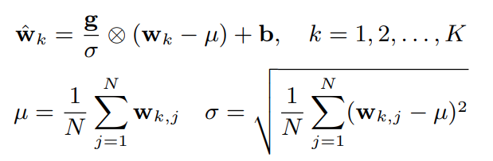
TasNet (2018): network design
Separation network
The estimation of the source masks is done with a deep LSTM network to model the time dependencies across the K segments, followed by a fully-connected layer with Softmax activation function for mask generation. The input to the LSTM network is the sequence of K mixture weight vectors w₁, . . . w_{K} ∈ R ^{1×N} , and the output of the network for source i is K mask vectors m_{i,1}, . . . , m_{i,K} ∈ R ^{1×N} . The procedure for estimation of the masks is the same as the T-F mask estimation (a set of masks are generated by several LSTM layers followed by a fully-connected layer with Softmax function as activation).
To speed up and stabilize the training process, the mixture weight vector w_{k} is normalized in a way similar to layer normalization
where parameters g ∈ R^{1×N} and b ∈ R^{1×N} are gain and bias vectors that are jointly optimized with the network. This normalization step results in scale invariant mixture weight vectors and also enables more efficient training of the LSTM layers.
Starting from the second LSTM layer, an identity skip connection is added between every two LSTM layers to enhance the gradient flow and accelerate the training process.

Slide 12


TasNet (2018): network design
Decoder for waveform reconstruction
The separation network produces a mask matrix for each source i M_{i} = [m_{i,1}, . . . , m_{i,K}] ∈ R^{K×N} from the mixture weight Wˆ = [wˆ₁, . . . , wˆ_{K}] ∈ R^{K×N} across all the K segments. The source weight matrices can then be calculated by
where D_{i} = [d_{i,1}, . . . , d_{i,K}] ∈ R ^{K×N} is the weight matrix for source i. Note that M_{i} is applied to the original mixture weight W = [w₁, . . . , w_{K}] instead of normalized weight Wˆ . The timedomain synthesis of the sources is done by matrix multiplication between D_{i} and the basis signals B ∈ R^{N×L}
For each segment, this operation can also be formulated as a linear deconvolutional operation (also known as transposed convolution), where each row in B corresponds to a 1-D filter which is jointly learned together with the other parts of the network. This is the inverse operation of the convolutional layer.
Finally we scale the recovered signals to reverse the effect of L² normalization of x_{k}. Concatenating the recoveries across all segments reconstruct the entire signal for each source.

Slide 13
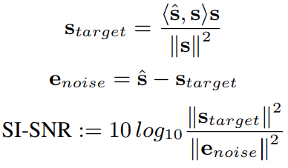
TasNet (2018): network design
Training objective
Since the output of the network are the waveforms of the estimated clean signals, we can directly use source-to-distortion ratio (SDR) as our training target. Here scale-invariant source-to-noise ratio (SI-SNR) is used, which is used as the evaluation metric in place of the standard SDR, as the training target. The SI-SNR is defined as
where ˆs ∈ R^{1×t} and s ∈ R^{1×t} are the estimated and target clean sources respectively, t denotes the length of the signals, and ˆs and s are both normalized to have zero-mean to ensure scale-invariance.

Slide 14
Conv-TasNet (2019)
While TasNet outperformed previous time-frequency speech separation methods in both causal and non-causal implementations, the use of a deep long short-term memory (LSTM) network as the separation module in the original TasNet significantly limited its applicability.
First, choosing smaller kernel size (i.e. length of the waveform segments) in the encoder increases the length of the encoder output, which makes the training of the LSTMs unmanageable.
Second, the large number of parameters in deep LSTM network significantly increases its computational cost and limits its applicability to low-resource, low-power platforms such as wearable hearing devices.
The third problem is caused by the long temporal dependencies of LSTM networks which often results in inconsistent separation accuracy, for example, when changing the starting point of the mixture.
Motivated by the success of temporal convolutional network (TCN) models , Conv-TasNet uses stacked dilated 1- D convolutional blocks to replace the deep LSTM networks for the separation step. The use of convolution allows parallel processing on consecutive frames or segments to greatly speed up the separation process and also significantly reduces the model size.
To further decrease the number of parameters and the computational cost, the original convolution operation is substituted with depthwise separable convolution

Slide 15
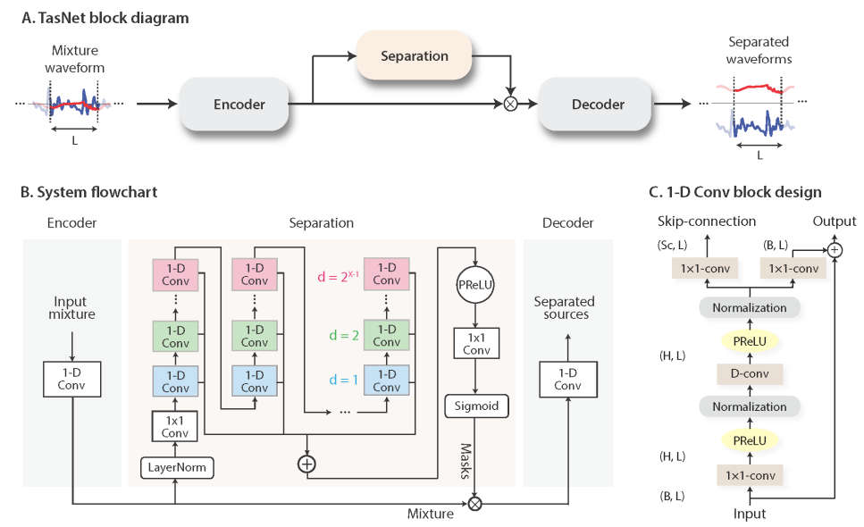
Conv-TasNet (2019)
The fully-convolutional time-domain audio separation network (Conv-TasNet) consists of three processing stages: encoder, separation, and decoder.
First, an encoder module is used to transform short segments of the mixture waveform into their corresponding representations in an intermediate feature space.
This representation is then used to estimate a multiplicative function (mask) for each source at each time step.
The source waveforms are then reconstructed by transforming the masked encoder features using a decoder module.

Slide 16

Conv-TasNet (2019): network design
Time-domain speech separation
The problem of single-channel speech separation can be formulated in terms of estimating C sources s₁(t), . . . , s_{c}(t) ∈ R^{1×T} , given the discrete waveform of the mixture x(t) ∈ R^{1×T} , where
In time-domain audio separation, we aim to directly estimate s_{i}(t), i = 1, . . . , C, from x(t)

Slide 17


Conv-TasNet (2019): network design
Convolutional encoder-decoder
The input mixture sound can be divided into overlapping segments of length L, represented by x_{k} ∈ R^{1×L}, where k = 1, . . . , Tˆ denotes the segment index and Tˆ denotes the total number of segments in the input. x_{k} is transformed into a N-dimensional representation, w ∈ R^{1×N} by a 1-D convolution operation, which is reformulated as a matrix multiplication (the index k is dropped from now on):
where U ∈ R^{N×L} contains N vectors (encoder basis functions) with length L each, and H(·) is an optional nonlinear function.H(·) is the rectified linear unit (ReLU) to ensure that the representation is non-negative. The decoder reconstructs the waveform from this representation using a 1-D transposed convolution operation, which can be reformulated as another matrix multiplication:
where xˆ ∈ R^{1×L} is the reconstruction of x, and the rows in V ∈ R^{N×L} are the decoder basis functions, each with length L. The overlapping reconstructed segments are summed together to generate the final waveforms.
Although we reformulate the encoder/decoder operations as matrix multiplication, the term ”convolutional autoencoder” is used because in actual model implementation, convolutional and transposed convolutional layers can more easily handle the overlap between segments and thus enable faster training and better convergence

Slide 18



Conv-TasNet (2019): network design
Estimating the separation masks
The separation for each frame is performed by estimating C vectors (masks) m_{i} ∈ R^{1×N} , i = 1, . . . , C where C is the number of speakers in the mixture that is multiplied by the encoder output w. The mask vectors m_{i} have the constraint that m_{i} ∈ [0, 1]. The representation of each source, d_{i} ∈ R^{1×N} , is then calculated by applying the corresponding mask, m_{i} , to the mixture representation w:
where ⊙ denotes element-wise multiplication. The waveform of each source ˆs_{i}, i = 1, . . . , C is then reconstructed by the decoder:
The unit summation constraint , was applied based on the assumption that the encoder-encoder architecture can perfectly reconstruct the input mixture

Slide 19
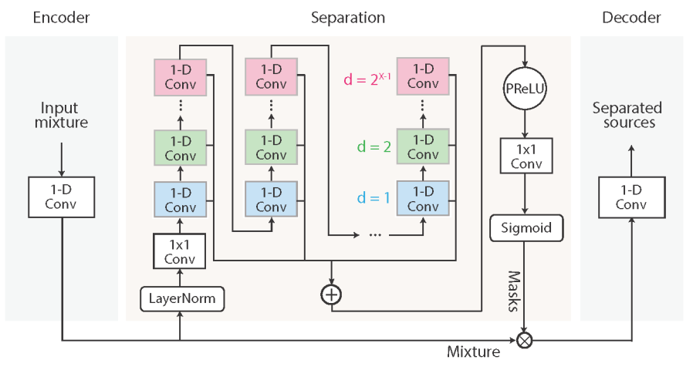
Conv-TasNet (2019): network design
Convolutional separation module
Motivated by the temporal convolutional network (TCN), a fully-convolutional separation module is proposed that consists of stacked 1-D dilated convolutional blocks. TCN was proposed as a replacement for RNNs in various sequence modeling tasks. Each layer in a TCN consists of 1-D convolutional blocks with increasing dilation factors.
The dilation factors increase exponentially to ensure a sufficiently large temporal context window to take advantage of the long-range dependencies of the speech signal,
In Conv-TasNet, M convolutional blocks with dilation factors 1, 2, 4, . . . , 2M−1 are repeated R times. The input to each block is zero padded accordingly to ensure the output length is the same as the input. The output of the TCN is passed to a convolutional block with kernel size 1 (1 × 1−conv block, also known as pointwise convolution) for mask estimation.
The 1×1−conv block together with a nonlinear activation function estimates C mask vectors for the C target sources.

Slide 20
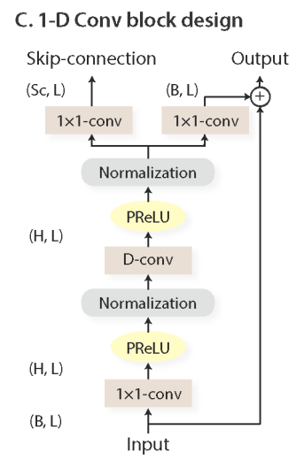

Conv-TasNet (2019): network design
Convolutional separation module
The design of the 1-D convolutional blocks: a residual path and a skip-connection path are applied: the residual path of a block serves as the input to the next block, and the skip-connection paths for all blocks are summed up and used as the output of the TCN. To further decrease the number of parameters, depthwise separable convolution (S-conv(·)) is used to replace standard convolution in each convolutional block.
The depthwise separable convolution operator decouples the standard convolution operation into two consecutive operations, a depthwise convolution (D-conv(·)) followed by pointwise convolution (1 × 1−conv(·)):
where Y ∈ R^{G×M} is the input to S-conv(·), K ∈ R^{G×P} is the convolution kernel with size P, y_{j} ∈ R^{1×M} and k_{j} ∈ R^{1×P} are the rows of matrices Y and K, respectively, L ∈ R^{G×H×1} is the convolution kernel with size 1, and ⊛ denotes the convolution operation.
In other words, the D-conv(·) operation convolves each row of the input Y with the corresponding row of matrix K, and the 1 × 1−conv block linearly transforms the feature space.
In comparison with the standard convolution with kernel size Kˆ ∈ R^{G×H×P} , depthwise separable convolution only contains G×P +G×H parameters, which decreases the model size by a factor of (H×P)/(H+P) ≈ P when H≫P

Slide 21

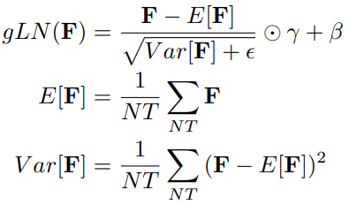
Conv-TasNet (2019): network design
Convolutional separation module
A nonlinear activation function and a normalization operation are added after both the first 1 × 1-conv and D-conv blocks respectively. The nonlinear activation function is the parametric rectified linear unit (PReLU)
where α ∈ R is a trainable scalar controlling the negative slope of the rectifier. The choice of the normalization method in the network depends on the causality requirement. For noncausal configuration, empirically found that global layer normalization (gLN) outperforms all other normalization methods. In gLN, the feature is normalized over both the channel and the time dimensions:
where F ∈ R ^{N×T} is the feature, γ, β ∈ R ^{N×1} are trainable parameters, and ϵ is a small constant for numerical stability.

Slide 22
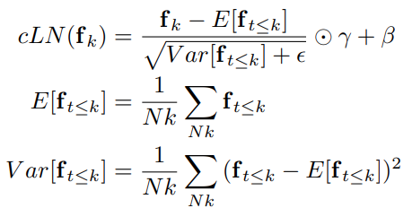
Conv-TasNet (2019): network design
Convolutional separation module
In causal configuration, gLN cannot be applied since it relies on the future values of the signal at any time step. Instead a cumulative layer normalization (cLN) operation is designed to perform step-wise normalization in the causal system:
where f_{k} ∈ R ^{N×1} is the k-th frame of the entire feature F, f_{t≤k} ∈ R ^{N×k} corresponds to the feature of k frames [f₁, . . . ,f_{k}], and γ, β ∈ R ^{N×1} are trainable parameters applied to all frames. To ensure that the separation module is invariant to the scaling of the input, the selected normalization method is applied to the encoder output w before it is passed to the separation module.

Slide 23
Conv-TasNet (2019): network design
Convolutional separation module
At the beginning of the separation module, a linear 1 × 1-conv block is added as a bottleneck layer. This block determines the number of channels in the input and residual path of the subsequent convolutional blocks.
For instance, if the linear bottleneck layer has B channels, then for a 1-D convolutional block with H channels and kernel size P, the size of the kernel in the first 1 × 1-conv block and the first D-conv block should be O ∈ R ^{B×H×1} and K ∈ R ^{H×P} respectively, and the size of the kernel in the residual paths should be L_{Rs} ∈ R ^{H×B×1} . The number of output channels in the skip-connection path can be different than B, and we denote the size of kernels in that path as L_{Sc} ∈ R ^{H×Sc×1} .

Slide 24
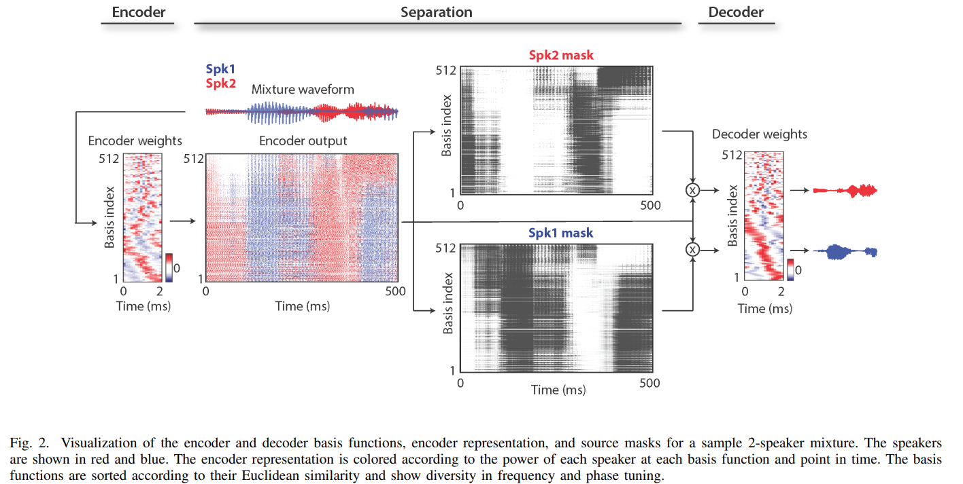
Conv-TasNet (2019): network design

Slide 25
SpeakerBeam (2020)
FD-Speakerbeam:
a target speech extraction method that exploits a speaker embedding vector derived from an adaptation or enrollment utterance of the target speaker to guide a neural network towards extracting speech of that speaker. This is realized by combining two networks, a sequence summary network that computes the speaker embedding vector from the amplitude spectrum of the adaptation utterance and a speech extraction network that accepts the amplitude spectrum of the speech mixture and the embedding vector as inputs and generates a time-frequency mask for extracting the target speaker.
TD-SpeakerBeam:
speech extraction network accepts time-domain signals of the mixture, and outputs directly the time-domain signal of the target speaker. The sequence summary network is replaced with a convolutional network to obtain richer speaker embedding vectors.
Moreover, to further improve speaker discrimination capability, TD-SpeakerBeam accepts spatial information from microphone array recordings as additional input features. Simply adding spatial features to the input of TD-SpeakerBeam may limit the potential to process spatial information. Consequently, an alternative approach is proposed, called internal combination, for exploiting spatial information more effectively within the SpeakerBeam framework

Slide 26
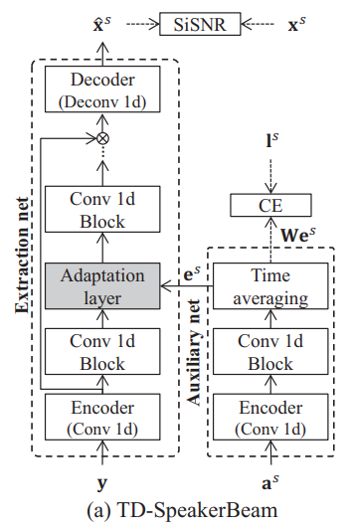
SpeakerBeam (2020): network design
TD-SpeakerBeam
Let y, a^{s} and xˆ^{s} be the time-domain signals of the speech mixture, the adaptation utterance, and the estimated target speech for target speaker s. SpeakerBeam is composed of two networks, an extraction network, and an auxiliary network. In the original FDSpeakerBeam, these networks accept the amplitude spectrum of the mixture and adaptation signals as inputs and generate a time-frequency mask. In this paper, we modify the implementation of these networks to input and output time-domain signals.
The time-domain extraction network follows a similar configuration as Conv-TasNet, i.e. it consists of a 1d convolution layer that accepts the mixture signal y (encoder layer), several convolution blocks, and finally, a 1d deconvolution (decoder layer) that outputs the extracted speech signal in the time-domain, xˆ^{s} .
There are two major differences with Conv-TasNet. First, the output consists of a single signal corresponding to the target speech only. Second, we insert an adaptation layer between the first and second convolution blocks1 to drive the network towards extracting the target speaker. The adaptation layer accepts a speaker embedding vector of the target speaker, e^{s} , as auxiliary information.
The target speaker embedding vector, e^{s} , is computed by the time-domain auxiliary network. In the original FD-SpeakerBeam, the auxiliary network consists of a sequence summary network, i.e. a few fully connected layers followed by a time-averaging operation. Here, using a convolutional auxiliary network is proposed to accept the time-domain input signal of the adaptation utterance a^{s} . The auxiliary network consists of an encoder layer and a single convolution block similar to those used in the extraction network

Slide 27


SpeakerBeam (2020): network design
Spatial features
Spatial information extracted from multi-channel recordings can provide an alternative source of information about the mixtures that could help discriminate speakers better. There have been several works showing the benefit of adding spatial features to the input of speech enhancement networks. For example, recently was showed that the inter-microphone phase difference (IPD) features could improve the separation performance of TasNet in reverberant conditions. The IPD of the mixture signal between two microphones is defined as
where Y_{i,t,f} ∈ C is the short-time Fourier transform (STFT) coefficient of the mixture signal at microphone i, t is the time-frame index, and f is the frequency index. Here we limit our investigation to the two-microphone case. We use cosine and sine of the IPDs as spatial features
where F is the number of frequency bins. Note that the frame size and window shift of the STFT used to compute the IPD features may differ from the window size and shift used in the encoder of the extraction network. IPD features are thus upsampled to match the settings of the extraction network
IPD features provide spatial information related to the direction of sources in the mixture. SpeakerBeam extracts the target speaker based on the speaker embedding vector, e^{s} , that may represent “spectral” information about the target speaker, but does not include spatial information. Consequently, it is not obvious how to efficiently combine the IPD features and the target speaker embedding vector as they represent different information. Here we consider two schemes, input combination and internal combination.

Slide 28
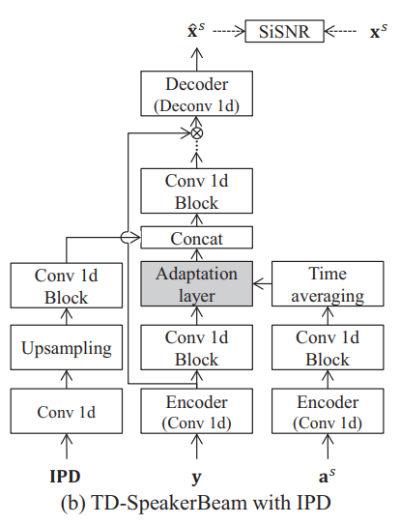
SpeakerBeam (2020): network design
Spatial features
The input combination is similar to that proposed for TasNet, where the IPD features (processed with a convolutional layer and upsampled) are concatenated to the output of the encoder layer of the extraction network. Input combination may force the initial convolution block to combine spatial information from the IPD features and “spectral” information from the mixture signal y into a “spectral” representation, which allows the adaptation layer (coming after the first convolutional block) to select the target speaker by comparing this “spectral” representation with the target speaker embedding vector, e^{s} . This may reduce the potential of the network to fully exploit spatial information by the upper layers of the network.
Figure shows a schematic diagram of TD-SpeakerBeam with the alternative internal IPD combination. It combines the IPD features (processed with a 1D convolutional layer, upsampling, and a convolution block) after the adaptation layer. Therefore, this lets the speaker selection operate based only on the “spectral” information, and the spatial information can be exploited by the upper layers without being obstructed by the adaptation layer.
Here, we only consider exploiting spatial information as additional information to the extraction network. Besides, SpeakerBeam can also be combined with beamforming, which is particularly efficient for ASR applications

Slide 29
SpeakerBeam (2020): network design
Multi-task learning with additional SI-loss
The extraction network and auxiliary networks are trained jointly from random initialization given the speech mixtures, y, adaptation utterances, a^{s} , and the target speech signals x^{s} . Previously SpeakerBeam was trained using only a target speech reconstruction loss. Here using a multi-task loss is proposed for training TD-SpeakerBeam that combines scale-invariant source-to-noise ratio (SiSNR) as signal reconstruction loss and cross-entropy-based SI-loss. The SI-loss is used to obtain more discriminative speaker embedding vectors. The multi-task loss is given by
where Θ are the model parameters, and l^{s} is a one-hot vector representing the target speaker ID, SiSNR(x^{s}, xˆ^{s}) is the SiSNR between the estimated and true target speech, CE(l^{s} , σ(We^{s})) is the cross entropy between the speaker label l^{s} and the speaker embedding vector projected onto the training speaker space, We^{s} , W is a projection matrix, σ(·) is a softmax function, and α is a scaling parameter.

Slide 30
Conformer (2020)
Combined convolutions with self-attention for ASR models.
Both global and local interactions are important for being parameter efficient.
Self-attention learns the global interaction whilst the convolutions efficiently capture the relative-offset-based local correlations.
Combination of self-attention and convolution is sandwiched between a pair feed forward modules

Slide 31
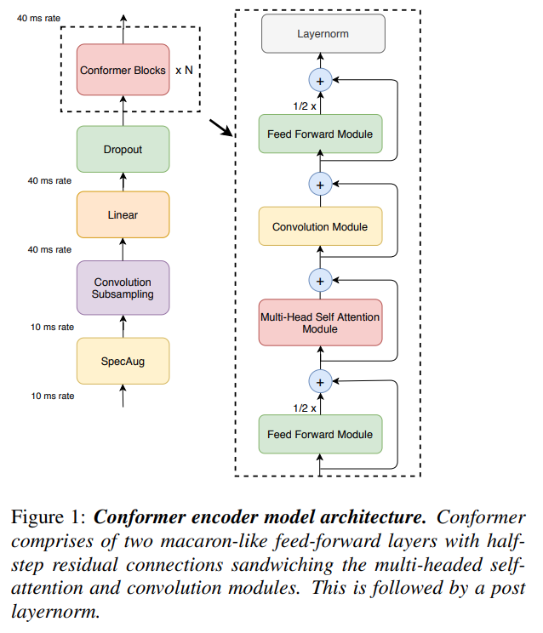
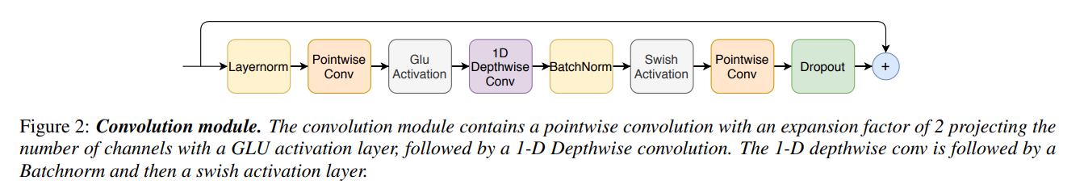
Conformer (2020)

Slide 32
Conformer (2020): network design
Audio encoder first processes the input with a convolution subsampling layer and then with a number of conformer blocks.
A conformer block is composed of four modules stacked together,
a feed-forward module,
a self-attention module,
a convolution module, and
a second feed-forward module in the end.

Slide 33
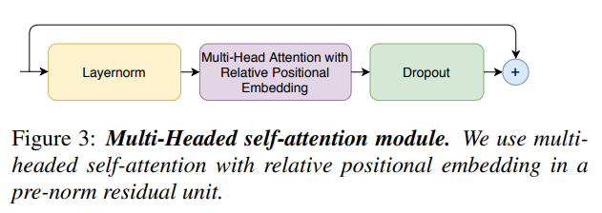
Conformer (2020): network design
Multi-Headed Self-Attention Module
Multi-headed self-attention (MHSA) is employed while integrating an important technique from Transformer-XL, the relative sinusoidal positional encoding scheme. The relative positional encoding allows the self-attention module to generalize better on different input length and the resulting encoder is more robust to the variance of the utterance length. Prenorm residual units with dropout are used which helps training and regularizing deeper models. Figure below illustrates the multi-headed self-attention block.

Slide 34
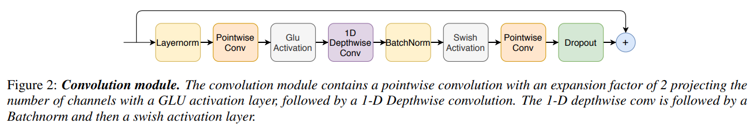
Conformer (2020): network design
Convolution module
The convolution module starts with a gating mechanism —a pointwise convolution and a gated linear unit (GLU). This is followed by a single 1-D depthwise convolution layer. Batchnorm is deployed just after the convolution to aid training deep models. Figure below illustrates the convolution block.

Slide 35
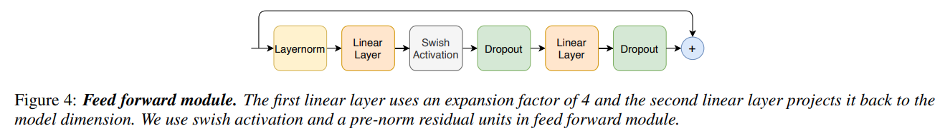
Conformer (2020): network design
Feed Forward Module
The Transformer architecture deploys a feed forward module after the MHSA layer and is composed of two linear transformations and a nonlinear activation in between. A residual connection is added over the feed-forward layers, followed by layer normalization. This structure is also adopted by Transformer ASR models. We follow pre-norm residual units and apply layer normalization within the residual unit and on the input before the first linear layer. We also apply Swish activation and dropout, which helps regularizing the network.

Slide 36
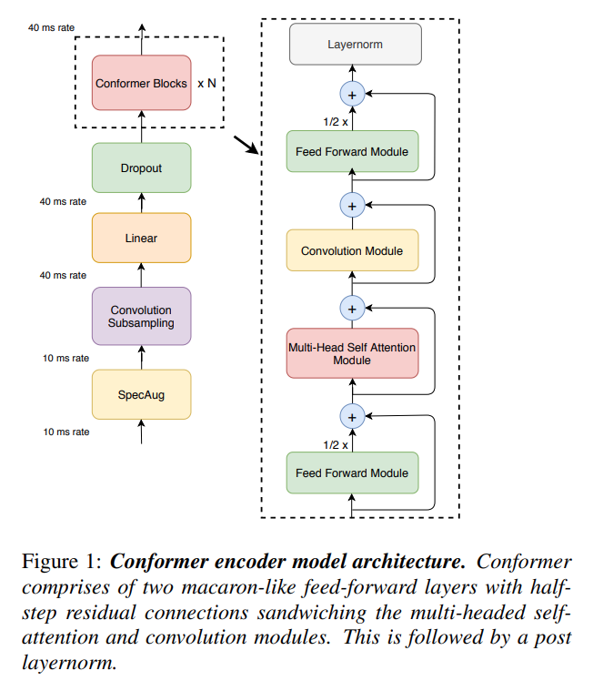
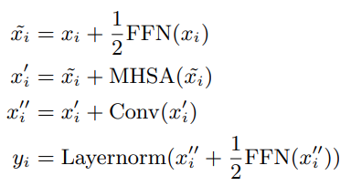
Conformer (2020): network design
Conformer block
Conformer block contains two Feed Forward modules sandwiching the Multi-Headed Self-Attention module and the Convolution module, as shown in Figure 1. This sandwich structure is inspired by Macaron-Net, which proposes replacing the original feed-forward layer in the Transformer block into two half-step feed-forward layers, one before the attention layer and one after. As in Macaron-Net, half-step residual weights are employed in feed-forward (FFN) modules. The second feed-forward module is followed by a final layernorm layer. Mathematically, this means, for input x_{i} to a Conformer block i, the output y_{i} of the block is:
where FFN refers to the Feed forward module, MHSA refers to the Multi-Head Self-Attention module, and Conv refers to the Convolution module as described in the preceding sections.

Slide 37
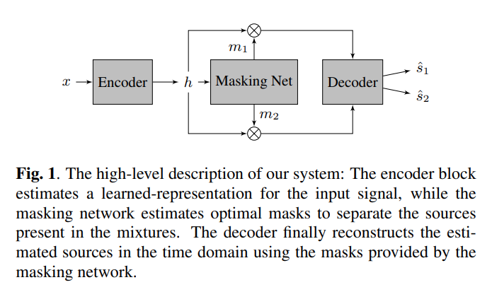
SepFormer (2021)
The SepFormer learns short and long-term dependencies with a multi-scale approach that employs transformers.
Сomposed of multi-head attention and feed-forward layers.
The dual-path framework is adopted introduced by DPRNN and RNNs are replaced with a multiscale pipeline composed of transformers that learn both short and long-term dependencies.
The dual-path framework enables to mitigate the quadratic complexity of transformers, as transformers in the dual-path framework process smaller chunks.

Slide 38

SepFormer (2021): network design
Encoder
The encoder takes in the time-domain mixture-signal x ∈ R^{T} as input, which contains audio from multiple speakers. It learns an STFT-like representation h ∈ R^{F ×T’} using a single convolutional layer:
The stride factor of this convolution impacts significantly on the performance, speed, and memory of the model.

Slide 39
SepFormer (2021): network design
Masking network
The masking network is fed by the encoded representations h ∈ R ^{F ×T’} and estimates a mask {m₁, . . . , m_{Ns}} for each of the Ns speakers in the mixture.
The encoded input h is normalized with layer normalization and processed by a linear layer (with dimensionality F). Then overlapping chunks of size C are created by chopping up h on the time axis with an overlap factor of 50%. Output of the chunking operation - h’ ∈ R ^{F ×C×Nc}, where C is the length of each chunk, and Nc is the resulting number of chunks. The representation h’ feeds the SepFormer block, which is the main component of the masking network. This block employs a pipeline composed of two transformers able to learn short and long-term dependencies. The output of the SepFormer h’’ ∈ R ^{F ×C×Nc} is processed by PReLU activations followed by a linear layer. We denote the output of this module h’’’ ∈ R ^{(F ×Ns)×C×Nc}, where Ns is the number of speakers. Afterwards we apply the overlap-add scheme and obtain h’’’’ ∈ R ^{F ×Ns×T’} . We pass this representation through two feed-forward layers and a ReLU activation at the end to finally obtain the mask mk for each of the speakers.

Slide 40
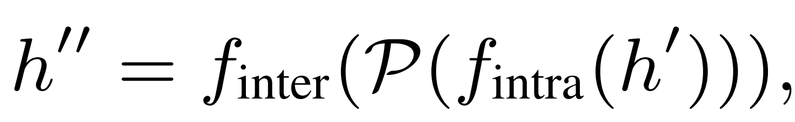
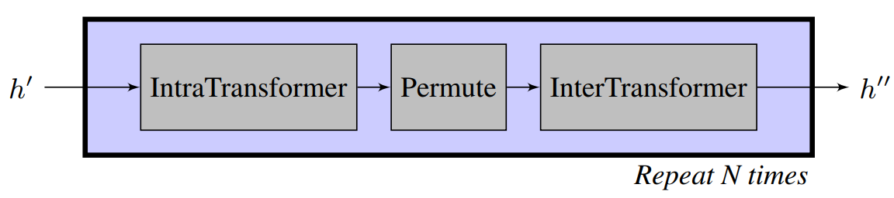
SepFormer (2021): network design
SepFormer block
Figure below shows the architecture of the SepFormer block. The SepFormer block is designed to model both short and longterm dependencies with the dual-scale approach of DPRNNs. In this model, the transformer block which models the short-term dependencies is named IntraTransformer (IntraT), and the block for longer-term dependencies is named InterTransformer (InterT). IntraT processes the second dimension of h’, and thus acts on each chunk independently, modeling the short-term dependencies within each chunk. Next, we permute the last two dimensions (which we denote with P), and the InterT is applied to model the transitions across chunks. This scheme enables effective modelling of long-term dependencies across the chunks. The overall transformation of the SepFormer is therefore defined as follows:
where we denote the IntraT and InterT with f_{inter}(.), and f_{intra}(.), respectively. The overall SepFormer block is repeated N times.

Slide 41
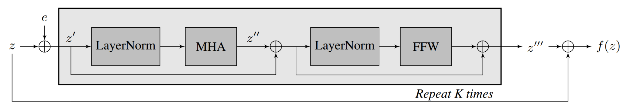
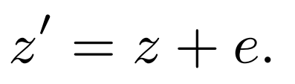
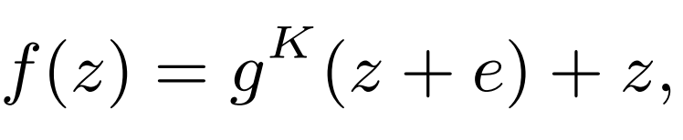
SepFormer (2021)
SepFormer block: Intra and Inter Transformers
Figure shows the architecture of the Transformers used for both the IntraT and InterT blocks. We use the variable z to denote the input to the Transformer. First of all, sinusoidal positional encoding e is added to the input z, such that,
Positional encoding injects information on the order of the various elements composing the sequence, thus improving the separation performance. We then apply multiple Transformer layers. Inside each Transformer layer g(.), we first apply layer normalization, followed by multi-head attention (MHA):
Each attention head computes the scaled dotproduct attention between all the elements of the sequence. The Transformer finally employs a feed-forward network (FFW), which is applied to each position independently:
The overall transformer block is therefore defined as follows:
where g ^{K}(.) denotes K layers of transformer layer g(.). We use K = N intra layers for the IntraT, and K = N inter layers for the InterT. As shown in figure , we add residual connections across the transformer layers, and across the transformer architecture to improve gradient backpropagation.

Slide 42
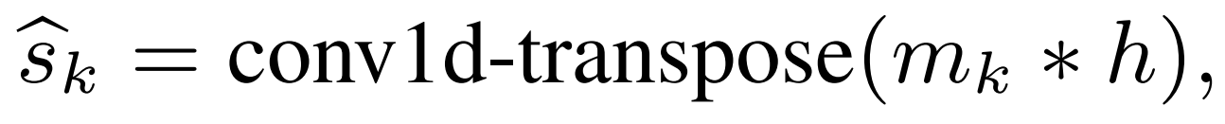
SepFormer (2021): network design
Decoder
The decoder simply uses a transposed convolution layer, with the same stride and kernel size of the encoder. The input to the decoder is the element-wise multiplication between the mask m_{k} of the source k and the output of the encoder h. The transformation of the decoder can therefore be expressed as follows:
where s_{k} ∈ R^{T} denotes the separated source k.

Slide 43
Thanks for attention!

